Slide 1
Cryptocurrency exchange system
Presented by team whatever: shuhao xia, man lang, li hua

Slide 2
Problem statement
Cryptocurrency, as a digital currency, is stored and traded in a totally different way from traditional financial assets.
Due to its special characteristics of decentralization and distributed ledger technology, a unique trading platform is required to meet the trading demands between cryptocurrency owners and investors.

Slide 3
approach
Our design simulates processes adopted in real cryptocurrency trading system, which includes submitting requests through brokers, matching process in exchange, and related processes such as creating new blocks, issuing new coins, etc.
The whole application is designed in eco-system pattern, which enables end-users to expand this trading system into a all-in-one platform by adding in new types of cryptocurrency.

Slide 4
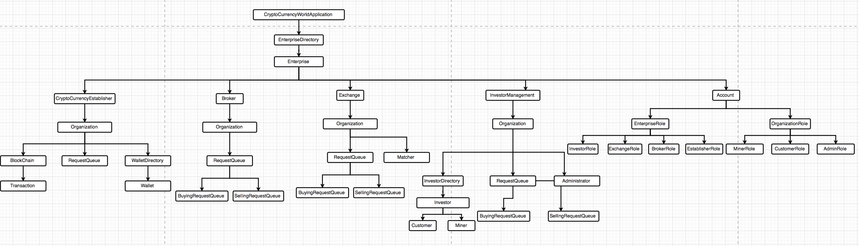
Object model

Slide 5
Roles & Use cases
System administrator: Manage networks, enterprises, and enterprise admins.
Cryptocurrency Establisher: Create repository for each currency.
Broker administrator: Responsible for managing brokers.
Exchange administrator: Manage exchange employees.
Broker: Responsible for managing buying/selling requests.
Matcher: To match buying/selling requests submitted to the exchange.
Customer: Investors who can only trade cryptocurrency on the platform.
Miner: Investors who can mine (get bonus coins) for writing transactions in the blocks.

Slide 6
Additional features
Fully simulate the whole life cycle of real cryptocurrency trading processes.
Sending reminder emails to newly registered users.
Price trending chart of historical deal price data to help predict future price.
Total ecosystem design.

Slide 7
screenshots
Key screens of the system

Slide 8
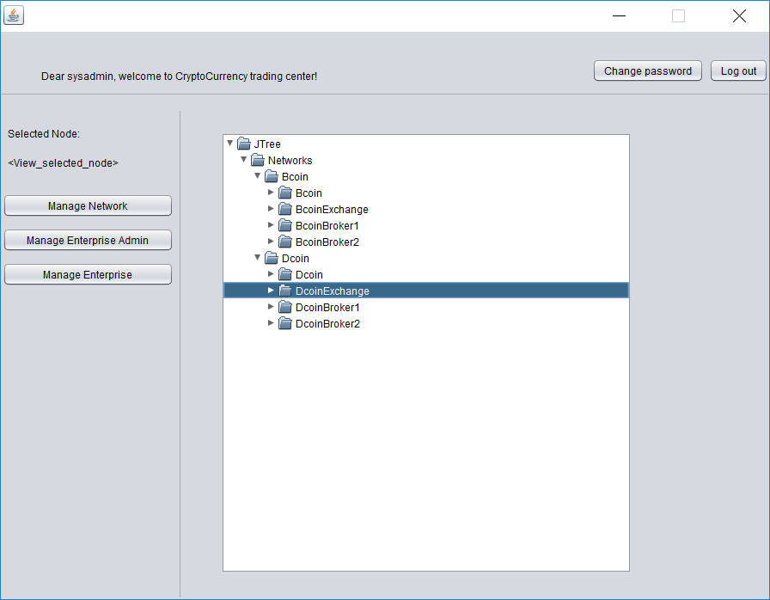
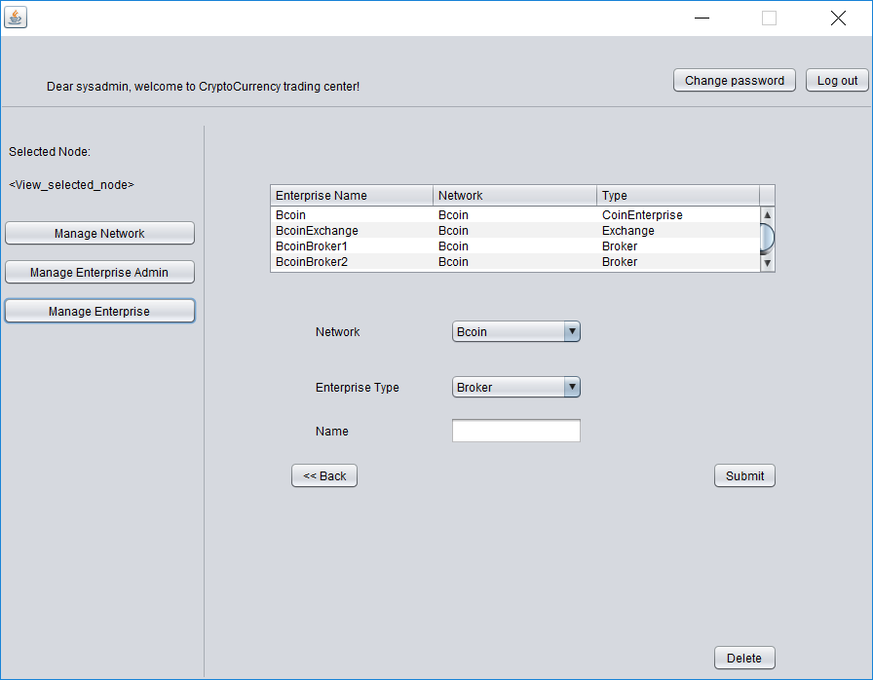
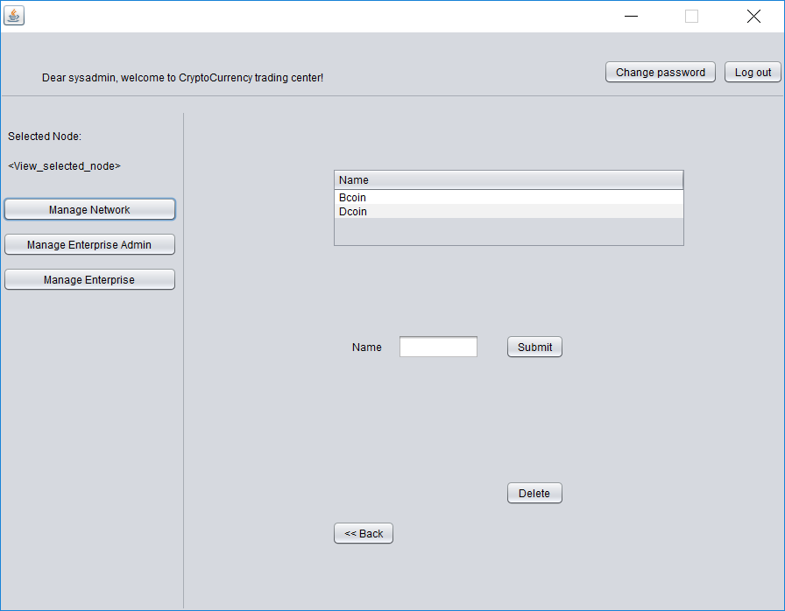
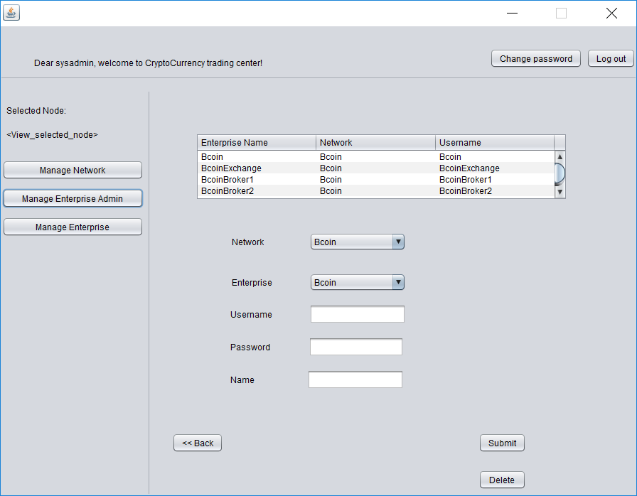
System Admin Panel
Show structure of this system
Create Enterprise in selected network
Create network and verify network name
Create Admin Account for Enterprise

Slide 9
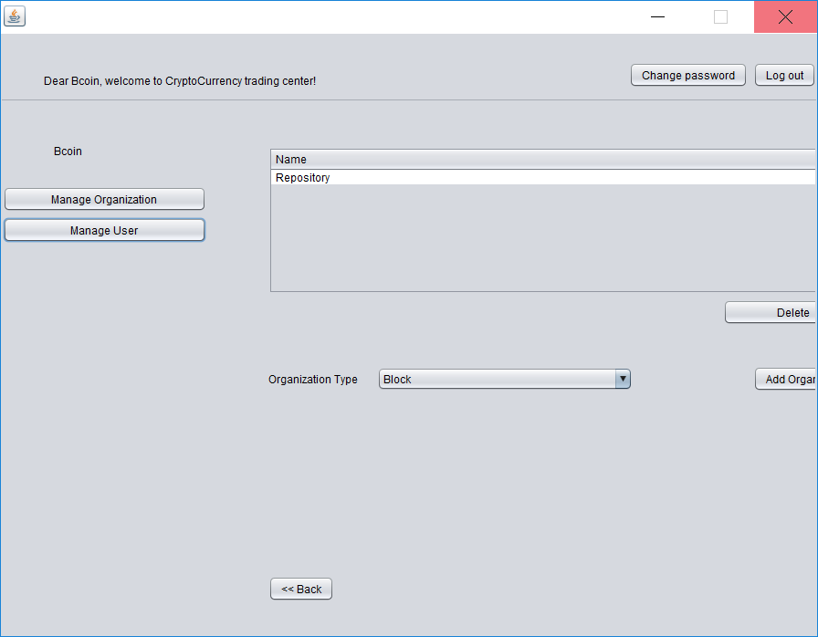
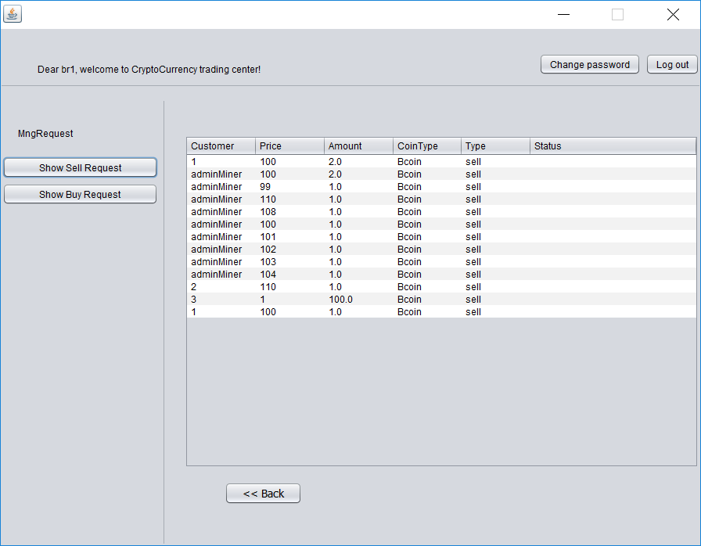
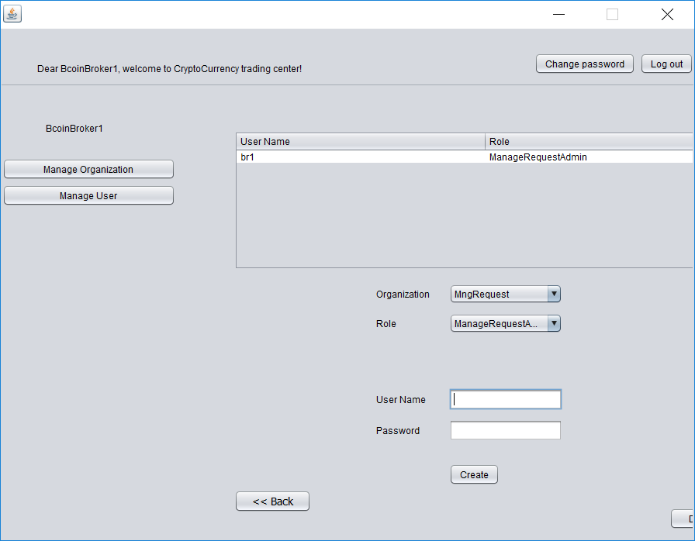
Enterprise Admin
Organization Admin
Manage Organizations and their admin account
under this enterprise
View all requests(sell/buy) sent to this broker(match).
Manage Organization Admin
Manage Organization account

Slide 10
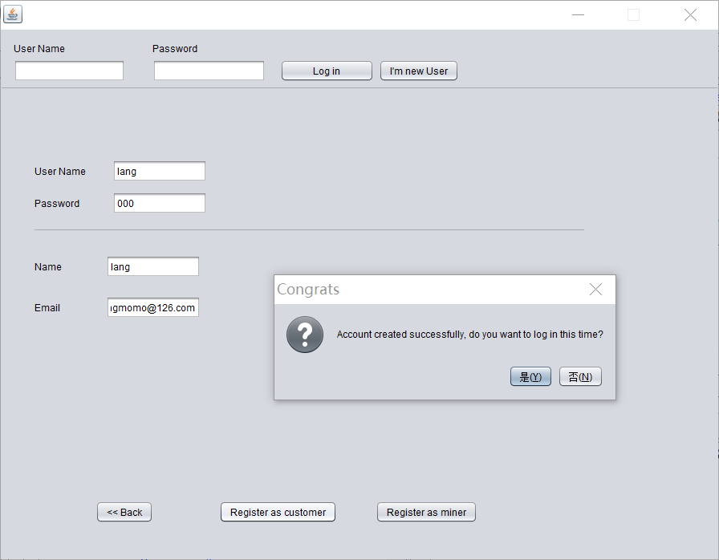
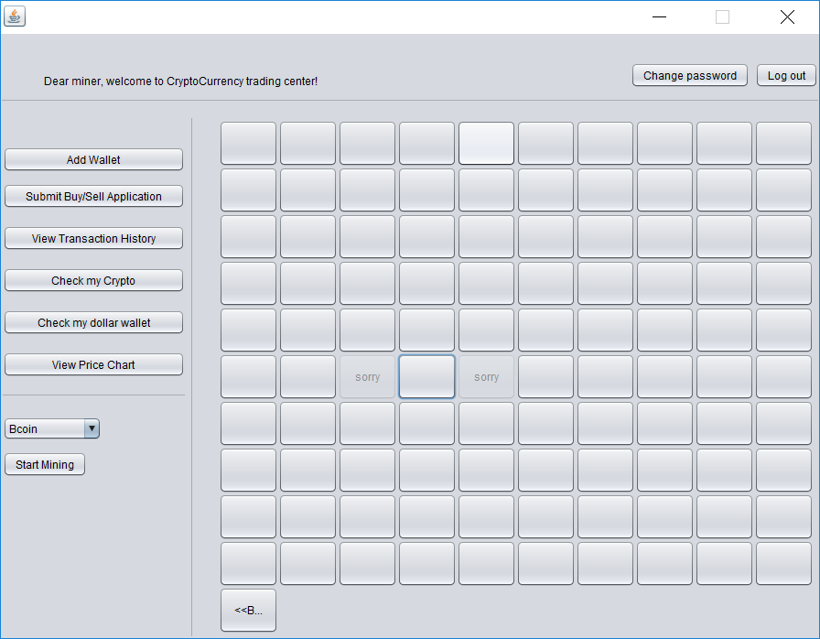
Register Customer
Miner Role
Register customer or miner(who is qualified for creating block)
Send login information to email address.
Buy or sell coin like customer
Choose Coin type and create next block by digging out coin.

Slide 11
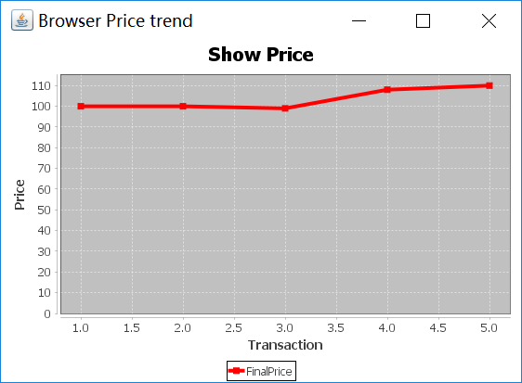
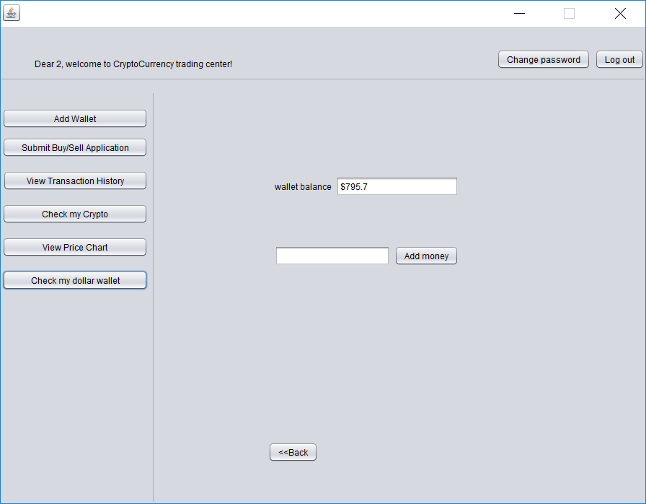
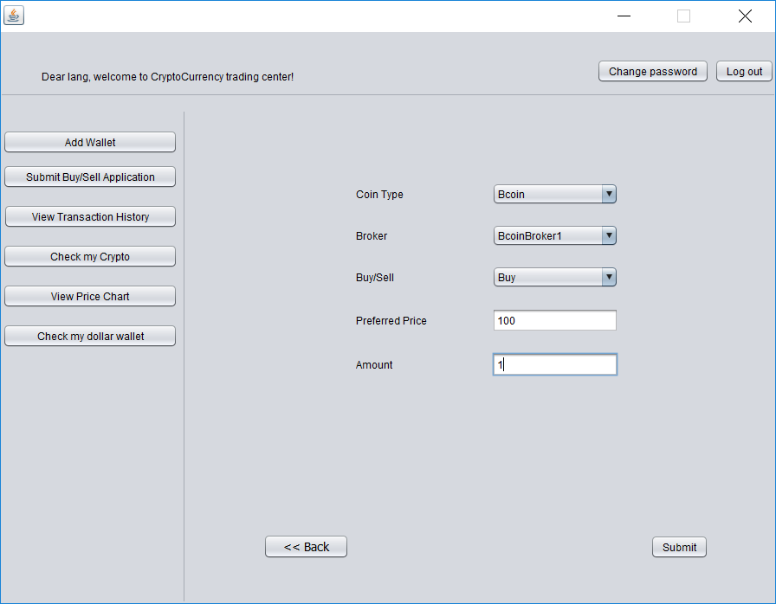
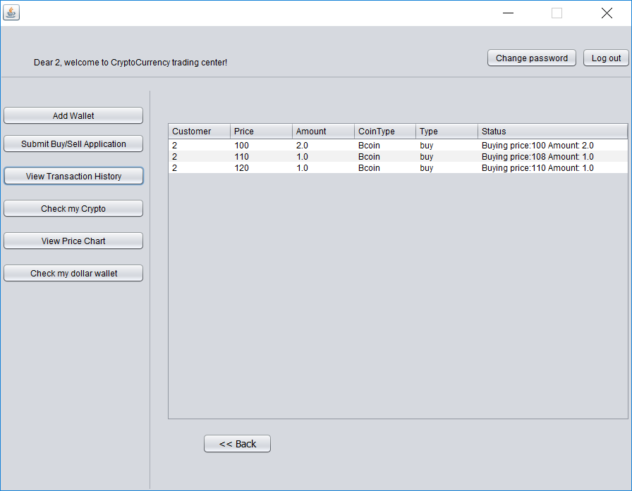
Customer Role
Check current sale price
Wallet Panel
Recharge and check balance
Request Panel
Transaction History Panel
Where customer can send buy/sell request to selected broker
View personal requests history. Show each request status and final sale price

Slide 12
End
Thank you
Team Whatever

